Slide 1

Impact of Double Taxation Treaties on Foreign Direct Investment: Evidence from large dyadic panel data
Panel Data Econometrics using Stata
Replication Paper
Barthel F., Busse M., Neumayer E.
Lisa Fadelli
30th June 2021

Slide 2
MOTIVATION AND RESEARCH QUESTION
DTT Double Taxation Treaty
= imposition of comparable taxes in two countries on the same taxpayer concerning the same subject matter and for identical periods
Research question:
Does the implementation of a DTT lead to a greater amount of FDI between the two countries?
→ The benefits associated would outweight the costs
Advantages of the Double Taxation Treaties:
Help to combat tax evasion and avoidance
Make information available for both countries
Mitigate the uncertainty in investing
→ Encourage FDI

Slide 3
VARIABLES
SAMPLE
The authors tested the effect of DTTs on FDI in a dyadic country dataset involving both developed and developing countries
→ Dyadic Fixed Effect estimation
Source country = where multinational enterprises have their domicile
Host country = where the FDIs take place
Dependent variable
lnfdiinstock = logarithm of the FDI stock
Control variables
hostgdptotln = logarithm of total host GDP
hostgdppcln = logarithm of host GDP per capita
hostinfllpn = logarithm of the inflation rate in the host country in %
hosttrade = ratio of a sum of exports and imports to GDP in the host country
rta = dummy variable for regional trade agreement
bit = binary variable for bilateral investment treaty
Year dummies 1978 to 2004
Explanatory variable of interest
dtt = presence of a DTT
Notes:
The purpose of their research was to adress some limitations raised from existing studies
The authors test the effect of DTTs on FDI in a dyadic country dataset in which both developed and developing countries are represented over a long period of time
The authors implement dyadic (related to interaction between two countries) fixed effect estimation measuring FDI in stock using 30 FDI source countries and 105 host countries
…
The dependent variable is lnfdiinstock referring to the logarithm of the FDI stock
The explanatory dummy variable of main interest is dtt which shows the presence of a DTT
As control variable they included the log of total host GDP to control the market size, the logarithm of host GDP per capita in nominal USD to control for the mean purchasing power of domestic consumers, the logarithm of the inflation rate in the host country in percent, measured by the GDP deflator. Then the ratio of a sum of exports and imports to GDP in the host country, to control for the openness of trade. Rta is the dummuy variable which takes on the value of 1 when a regional trade agreement is set
And bit is a binary variable that controls for the existence of a bilateral investment treaty
The analysis covers a period from 1978 to 2004, and they added year specific time dummy variables to account for any trends in the total FDI.

Slide 4


ESTIMATION MODELS
Purpose of the replication paper:
Criticize the estimation models chosen by the authors
STATIC FIXED EFFECT MODEL
DYNAMIC FIXED EFFECT MODEL
GMM ARELLANO BOND
Tends to overestimate the effect of BIT and DTT as it ignores the dynamic nature of FDI → biased
DYNAMIC LINEAR PANEL DATA MODEL
!! Endogeneity in the explanatory variable
$$y_{it}=γ_{1}y_{i,t−1}+β′x_{it}+α_{i}+v_{it}$$
With $x_{it}=\left(x_{it1}, …, x_{itk}\right)′$ and $β=(β_{1},…, β_{k})′$

Slide 5

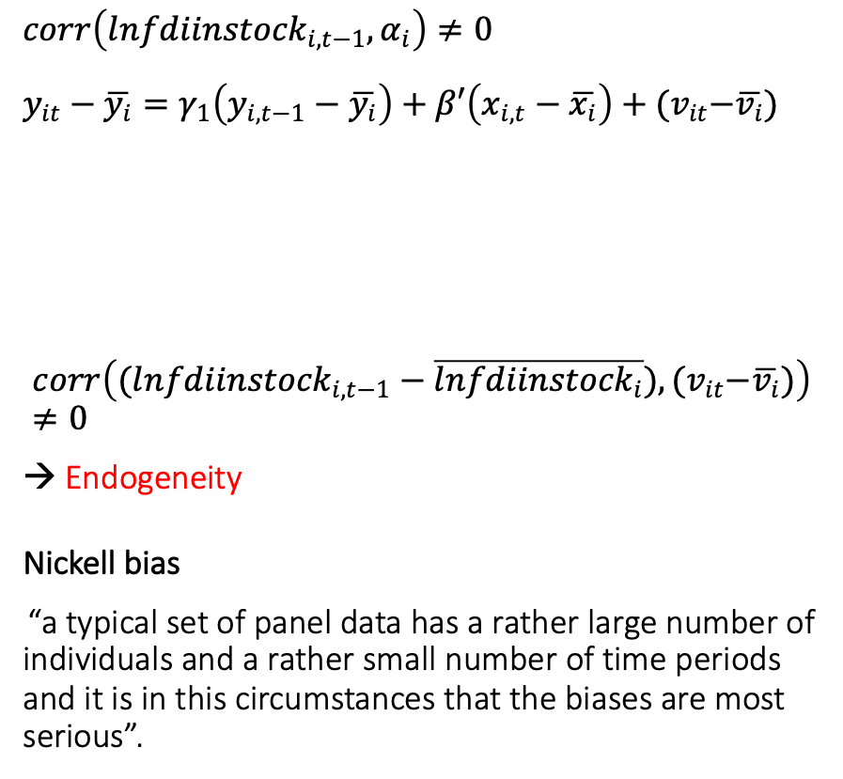




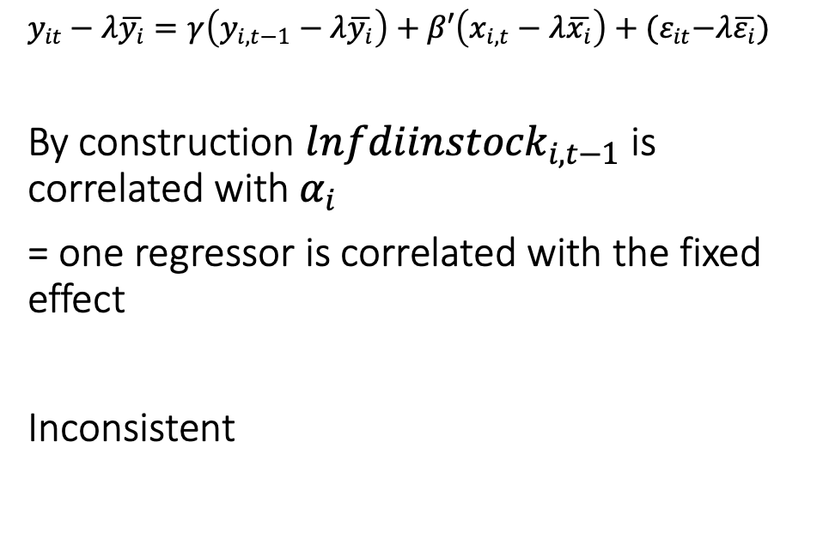

A SUITABLE MODEL
FIXED EFFECT
RANDOM EFFECT
$corr\left(l{nfdiinstock}_{i,t−1}, α_{i}\right)≠0$
$$y_{it}−\overline{y_{i}}=γ_{1}\left(y_{i,t−1}−\overline{y_{i}}\right)+β′\left(x_{i,t}−\overline{x_{i}}\right)+{(v}_{it}−\overline{v_{i}})$$
$$corr\left((l{nfdiinstock}_{i,t−1}−\overline{l{nfdiinstock}_{i}}), {(v}_{it}−\overline{v_{i}})\right)≠0$$
→ Endogeneity
Nickell bias
“a typical set of panel data has a rather large number of individuals and a rather small number of time periods and it is in this circumstances that the biases are most serious”.
$y_{it}−λ\overline{y_{i}}=γ\left(y_{i,t−1}−λ\overline{y_{i}}\right)+β′\left(x_{i,t}−λ\overline{x_{i}}\right)+{(ε}_{it}−λ\overline{ε_{i}})$
By construction $l{nfdiinstock}_{i,t−1}$ is correlated with $α_{i}$
= one regressor is correlated with the fixed effect
Inconsistent
$$y_{it}$$
$$v_{it}$$
$$y_{it−1}$$
$$v_{it−1}$$
$$y_{it−1}$$
$$\overline{v_{i}}$$

Slide 6

A SUITABLE MODEL
FIRST DIFFERENCED
Correlation $∆l{nfdiinstock}_{i,t−1}$and $∆v_{i,t}=v_{i,t}−v_{i,t−1}$ $l{nfdiinstock}_{i,t−1}$ depends on $v_{i,t−1}$ Inconsistent
$$={{lnfdiinstock}_{i,t−1}−lnfdiinstock}_{i,t−2}$$
Important to find an instrument
- highly correlated with the endogenous variable and
- uncorrelated with the error term
In the model, $∆v_{i,t}$ is uncorrelated with ${lnfdiinstock}_{i,t−k}$ for k higher or equal to 2.
The lagged levels of endogenous variable, three or more period before, can be used as instruments
METHOD OF MOMENTS
GMM
ARELLANO BOND
T is higher than 3 and the model is overidentified.

Slide 7

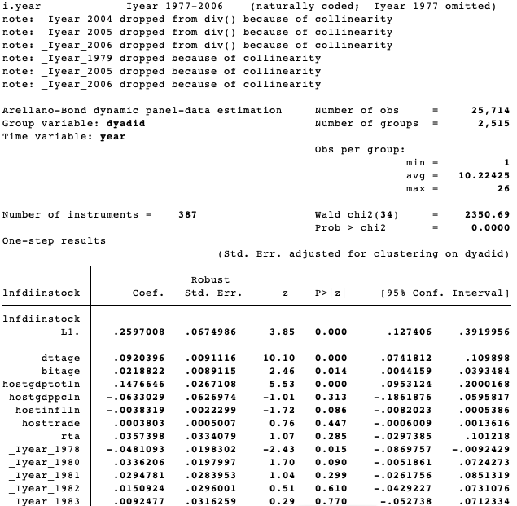
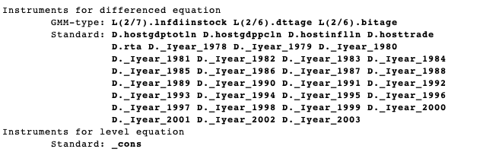
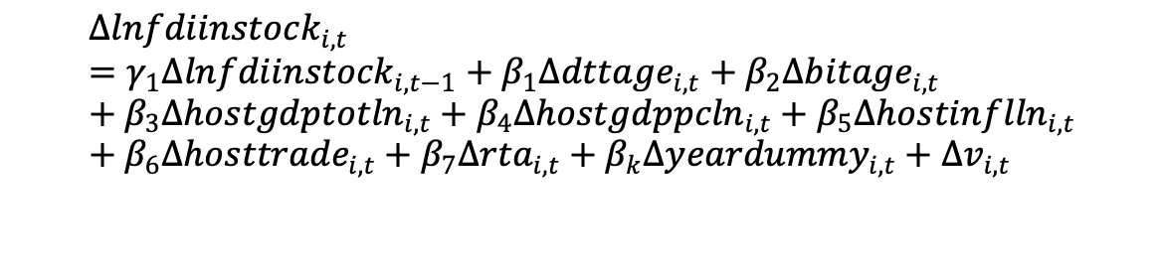
GMM ARELLANO BOND
$$∆{lnfdiinstock}_{i,t}={γ_{1}∆lnfdiinstock}_{i,t−1}+β_{1}{∆dttage}_{i,t}+β_{2}∆{bitage}_{i,t}+β_{3}∆{hostgdptotln}_{i,t}+β_{4}∆{hostgdppcln}_{i,t}+β_{5}{∆hostinflln}_{i,t}+β_{6}{∆hosttrade}_{i,t}+β_{7}∆{rta}_{i,t}+{β_{k}∆yeardummy}_{i,t}+{∆v}_{i,t}$$
A variable that measures the years passed since becoming effective, with the year of conclusion set on one.
…

Slide 8
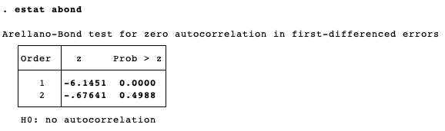
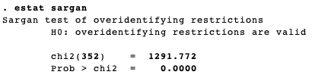
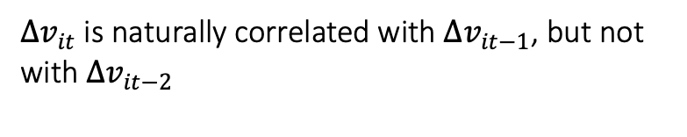


TESTS
GMM Arellano Bond is not valid if there is serial correlation in the first differenced residual
H0:$cov\left({∆v}_{it},{∆v}_{it−k}\right)=0$ where $k≥2$
${∆v}_{it}$ is naturally correlated with ${∆v}_{it−1}$, but not with ${∆v}_{it−2}$
The null implies that all instruments are valid (exogenous) and the model is correctly specified.
H0: $E\left[Z_{i,t}, m\right]=$ $E\left[Z_{i,t}, ∆v_{i,t}\right]=0$
Only for a homoscedastic error term, the Sargan test has an asymptotic chi-squared distribution

Slide 9
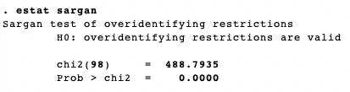
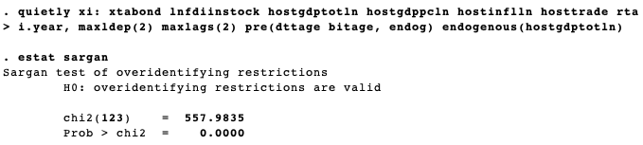
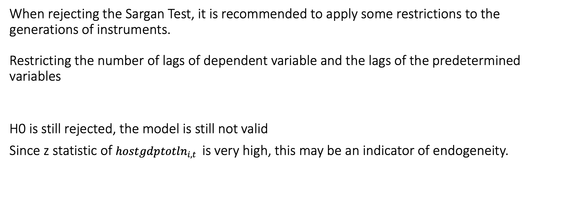
When rejecting the Sargan Test, it is recommended to apply some restrictions to the generations of instruments.
Restricting the number of lags of dependent variable and the lags of the predetermined variables
H0 is still rejected, the model is still not valid
Since z statistic of ${hostgdptotln}_{i,t}$ is very high, this may be an indicator of endogeneity.

Slide 10
CONCLUSION
They used an impressive number of countries to avoid sample selection bias
The static model is not taken into consideration because it is very likely that the Foreign Direct Investment stocks are highly correlated with the events in the past
Rejecting Sargan Test indicates that instruments are not exogenous or that the model is not well specified.
There is a positive relationship between the DTT and FDI

